Slide 1




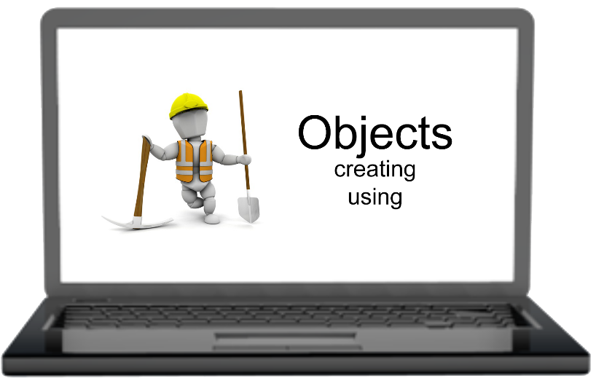
Team Project “Mind Mapping” Team 17
Chapter 11: Creating and Using Objects
Krasimir Krustev
Team Member
Telerik Software Academy
http://academy.telerik.com

Slide 2
Team Members
Members contributed to the project
Angel Stoyanov a.k.a. angel.n.stoyanov
Yordan Darakchiev a.k.a. iordan_93
Ginka Yankova a.k.a. gianyy
Krasimir Krustev a.k.a. krasimir.krustev86

Slide 3
How we organized our work
Team meetings
Skype
Version Control System
Mind Map repository for Chapter 11
Commits Log

Slide 4
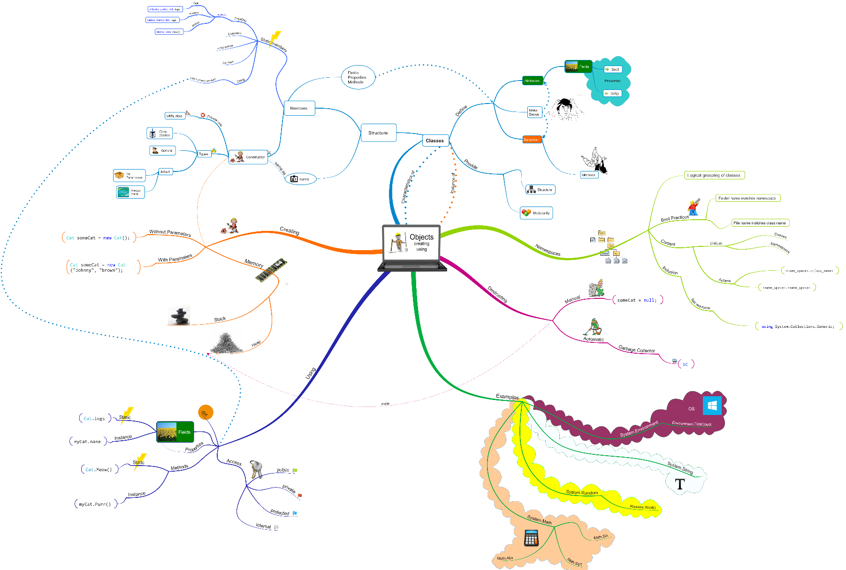
Mind Map of Chapter 11

Slide 5
Thank you for your attention

